Slide 1

Network Layer: Goals of Network Layer, Services provided to Transport layer and Internal Organization
Computer Communication Networks
Session 10
Tutor: Karma Wangchuk

Slide 2

Network Layer
Learning Outcome:- At the end of the lesson, you are expected to be able to:
  Need for Network Layer
  Identify Design Issues
  Discuss Goals of Network Layer
  Service provided to Transport Layer
  Internal Organization

Slide 3
Network Layer: Introduction
Introduction: Network Layer
  It is the third layer in the OSI Model.
  Network layer is concern with getting packets from the source all the way to the destination.
    Getting to the destination may require making many hops at intermediate routers along the way.
  To achieve its goals, network layer must know about the topology for the communication set of all routers and
    choose the appropriate paths through it

Slide 4
Network Layer: Need
Need for Network Layer:
  To solve the problem of packet delivery through several links, a network layer was designed (some times called as internet layer)
  Responsibility: Host-to-Host delivery and routing the packets through routers or switches.
Network layer in an internetwork

Slide 5
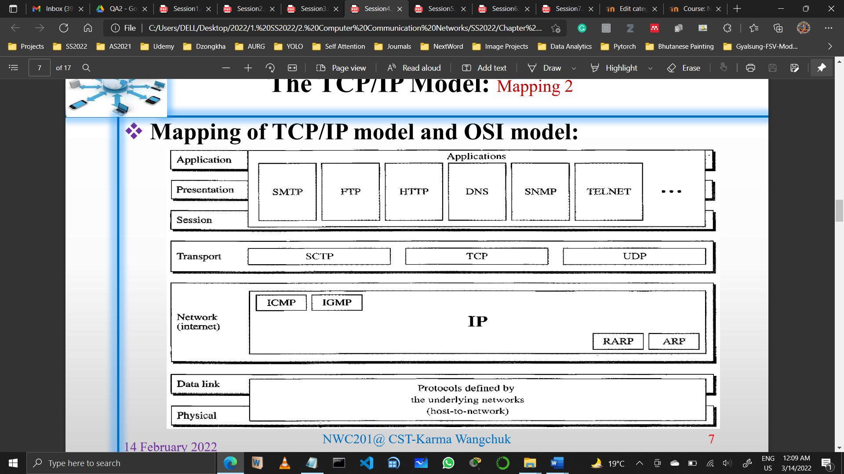
Network Layer: Need
Need for Network Layer:
  The functionality of the network layer at a source, at a router and at a destination
  At a source:
      Creating a packet coming from another protocol (Transport layer protocol/routing protocol)
      Header of packet contains logical addresses of source and destination
      Checking its routing information- outgoing interface of packet or physical address of the next node.

Slide 6
Network Layer: Need
Need for Network Layer:
  The functionality of the network layer at a source.

Slide 7
Network Layer: Need
Need for Network Layer:
  At a router or switch:
      Responsible for routing the packet.
      When packet arrives, it finds the interface from which packet is sent then change in the header, with the routing information send to the data link layer.

Slide 8
Network Layer: Need
Need for Network Layer:
  The functionality of the network layer at a router.

Slide 9
Network Layer: Need
Need for Network Layer:
  At a Destination:
      Verify the address – destination address on the packet match the address of the host.
      Reassemble the fragmented packet and deliver it to transport layer.

Slide 10
Network Layer: Need
Need for Network Layer:
  The functionality of the network layer at a destination

Slide 11
Network Layer: Need
Design Issues:
  There are four Network Layer Design Issues:
    Store and Forward Packet Switching
    Services Provided to the Transport Layer
    Implementation of Connectionless Services
    Implementation of Connection Oriented Services

Slide 12
Network Layer: Design Issues
Goal of the Network Layer:
  What kind of services the network later provides to the Transport later?
  The Network layer services have been design with the following goals in mind:
      The services should be independent of the underlying(router) technologies.
      The Transport layer should be shielded from the number, type and topology for the routers present.
      The network addresses available to the Transport Layer should use a uniform numbering plan (even across LANs and WANs).
  With these goals in mind, two different types of services emerged
      Connectionless Services
      Connection-oriented Services

Slide 13
Network Layer: Design Issues
Services provided to Transport Layer:
  Connectionless Services
    Internet community (based on nearly 30 years of actual experiences with the real, working computer network).
    Network layer protocol treats each packet independently, no relationship among the packets.
    Packet may or may not travel the same path to their destination
    Used datagram approach to packet switching.
    Why such decision?
        Internet is made of so many heterogeneous networks.

Slide 14
Network Layer: Design Issues
Services provided to Transport Layer:
  Connection-oriented Services
    Telephone companies (Based on 100 years of successful experience with the worldwide telephone system)
    The source first make a connection with the destination before sending a packet.
    When connection is established, a sequence of packets from same source to same destination can be sent sequentially.
    They are sent on the same path in sequential order (Relationship among packets exists)
    When sequence of packets delivered, connection terminates.
    Used Virtual Circuit to packet switching.

Slide 15
Network Layer: Internal Organization
Internal Organization of the Network Layer:
  Virtual Circuit (Message switching)
      Do not choose new route per packet
      Establish route and re-use
      Terminate route when terminate connection
      Users see continuous stream of data
      Primarily for the connection-oriented services
  Datagram (Packet switching)
      No advance routes
      Each packet routed independently
      More work but more robust
      Store and forward

Slide 16
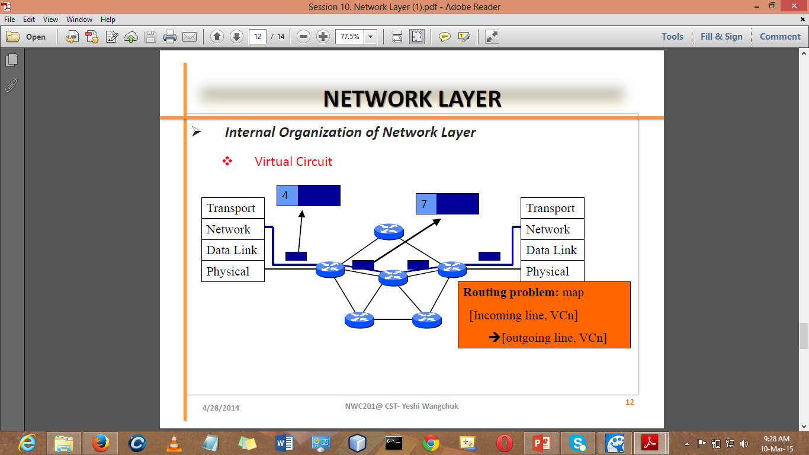
Network Layer: Internal Organization
Internal Organization of the Network Layer:
  Virtual Circuit (Message switching)

Slide 17
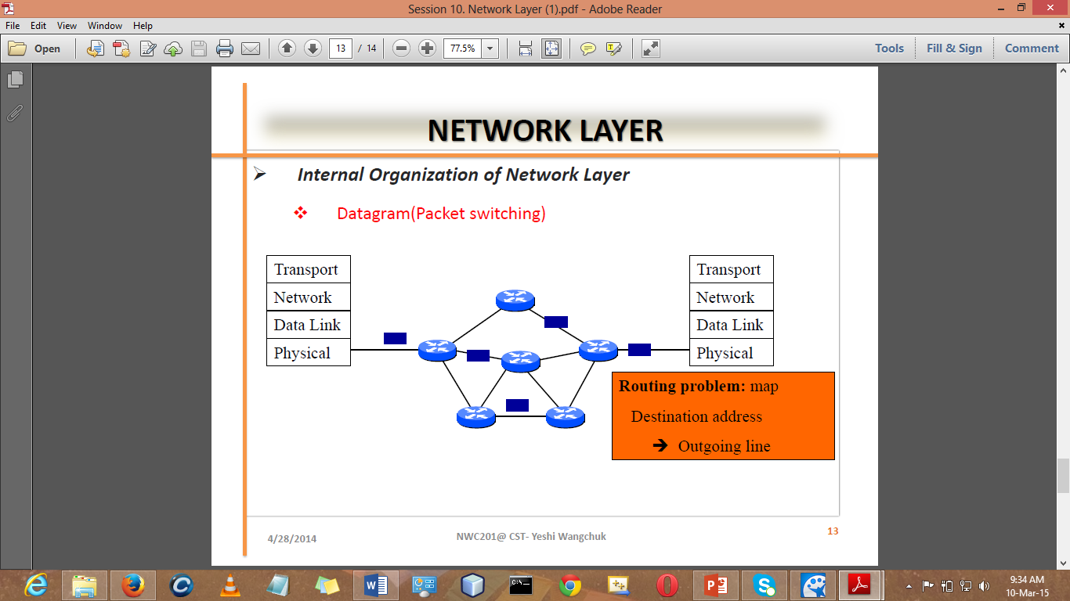
Network Layer: Internal Organization
Internal Organization of the Network Layer:
  Datagram (Packet switching)

Slide 18
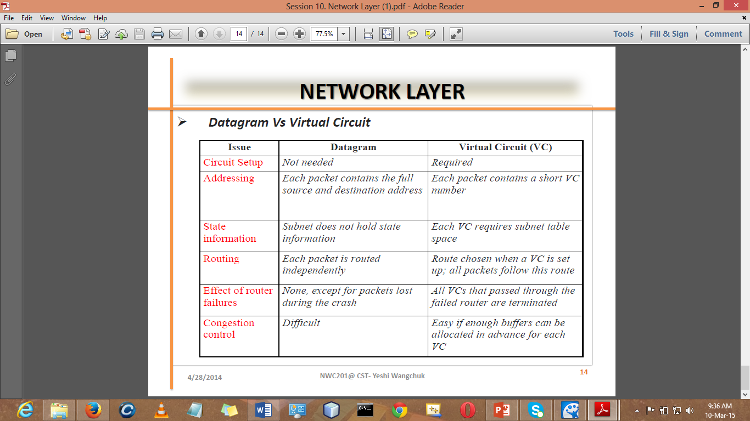
Network Layer: Internal Organization
Internal Organization of the Network Layer:
  Datagram Vs Virtual Circuit

Slide 19
Network Layer: Internal Organization
Difference: Connectionless and Connection Oriented protocols
  In connectionless communication, there is no need to establish connection between source (sender) and destination (receiver).
    But in connection-oriented communication connection must established before data transfer.
  Connection-oriented communication is more reliable then connectionless communication.

Slide 20
Network Layer: Internal Organization
Difference: Connectionless and Connection Oriented protocols
  In connection-oriented communication information can be resend if there is an error in receiver side ( missing data, corrupt data etc. ).
    But in connectionless communication it is not possible because the destination does not inform the source about data is received or not.
  Connection-oriented communication have higher overhead and place greater demands on bandwidth.
    But in connectionless communication requires far less overhead than connection-oriented communication.

Slide 21
Recapitulation
We have learned:
  Need for network layer
  Goals of network layer and two services:
        Connectionless services
        Connection-oriented Service
  Internal Organization of Network layer
        Message Switching
        Packet Switching

Slide 22
References
References:
  Stallings, W., Data & Computer Communication, Prentice-Hall
  Tanenbaum, Computers Networks, PHI
  Forouzan, B.A., Data Communication & Networkings, 4th Edition.
  Mr. Yeshi Wangchuk’s CCN Class Slides (2014), College of Science and Technology, Rinchending, Phuentsholing, Bhutan

Slide 23
See you in next class.

